Slide 1
DV UNIT-1 Chapter-1 The Context of DV Chapter-2 Setting the purpose and identifying the key factors

Slide 2
Chapter-1 The Context of Data Visualization
Visualization as a discovery tool
The bedrock of visualization knowledge
Defining data visualization
Visualization skills for the masses
The data visualization methodology

Slide 3
Visualization as a discovery tool
DV is the multi-talented, boundary-spanning trendy kid that has seen many esteemed people over the past few years, such as Hal Varian, forecasting this as one of the next big things.
One of the most compelling arguments for the value of data visualization is expresses in “The greatest value of a picture is when it forces us to notice what we never expected to see.(by John W Tukey –Exploratory Data Analysis)
Through visualization, we are seeking to portray data in ways that allow us to see it in a new light, to visually observe patterns, exceptions and the possible stories that sit behind its raw state. This is about considering visualization as a tool for discovery.

Slide 4
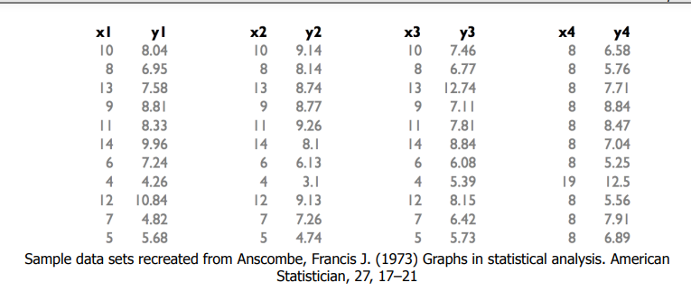
Visualization as a discovery tool
Example:
A well known demonstration that supports this notation was developed by noted statistician Francis Anscombe in the 1970s. He compiled an experiment involving four sets of data, each exhibiting almost identical statistical properties including mean, variance and correlation. This is known as “Anscombe’s quartet”.

Slide 5
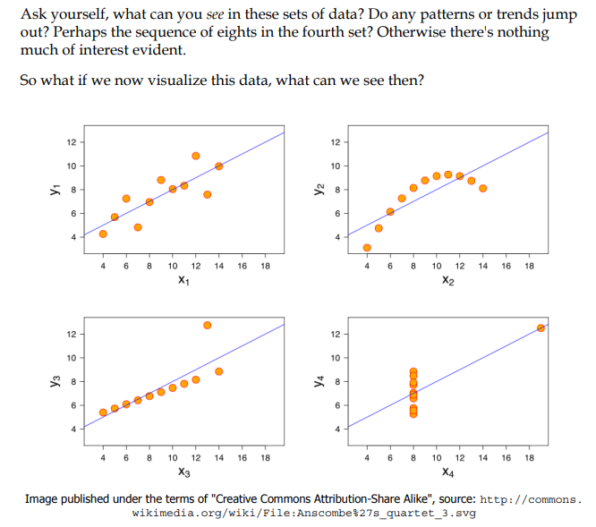
Visualization as a discovery tool

Slide 6
Visualization as a discovery tool
Through the previous graphical display, we can immediately see the prominent patterns created by the relationships between the X and Y values across the four sets of data as follows:
The general tendency about a trend line in X1,Y1
The curve patterns of X2, Y2
The strong linear pattern with single outlier in X3, Y3.
The similar strong linear pattern with an outlier for X4, Y4
It is much easier to discover and confirm the presence of patterns, relationships and physical characteristics such as outliers through a visual display, reinforcing the essence of Tukey’s quote about the value of the picture.
Data visualization is about a discovery process, enabling the reader to move from just looking at data to actually seeing it.

Slide 7
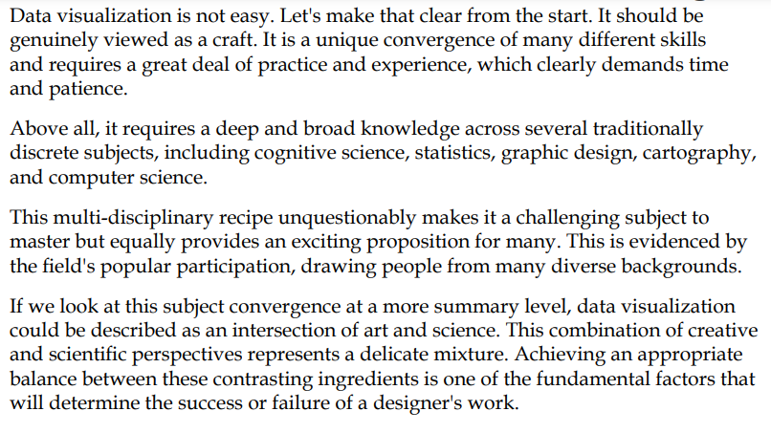
The bedrock of visualization knowledge

Slide 8
The bedrock of visualization knowledge

Slide 9
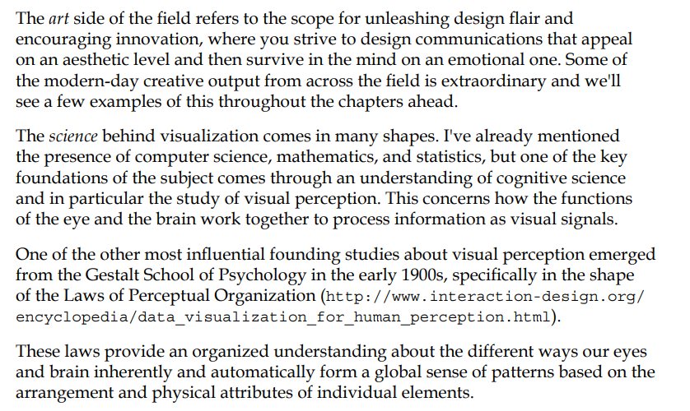
The bedrock of visualization knowledge

Slide 10
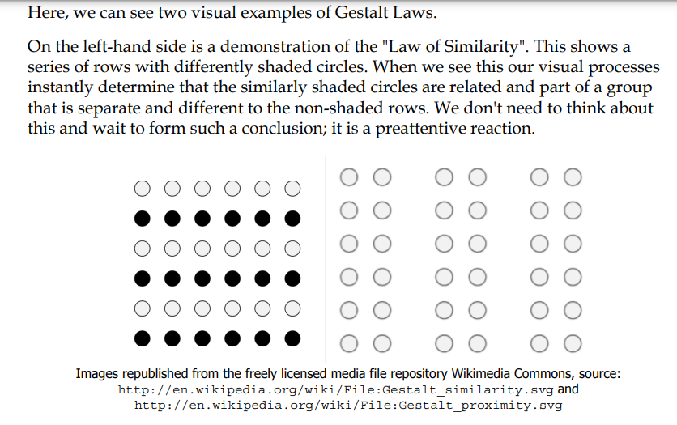
The bedrock of visualization knowledge

Slide 11
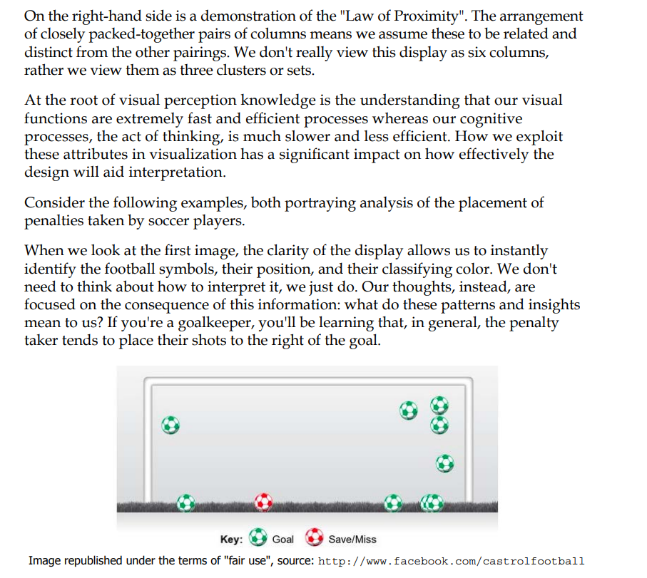
The bedrock of visualization knowledge

Slide 12
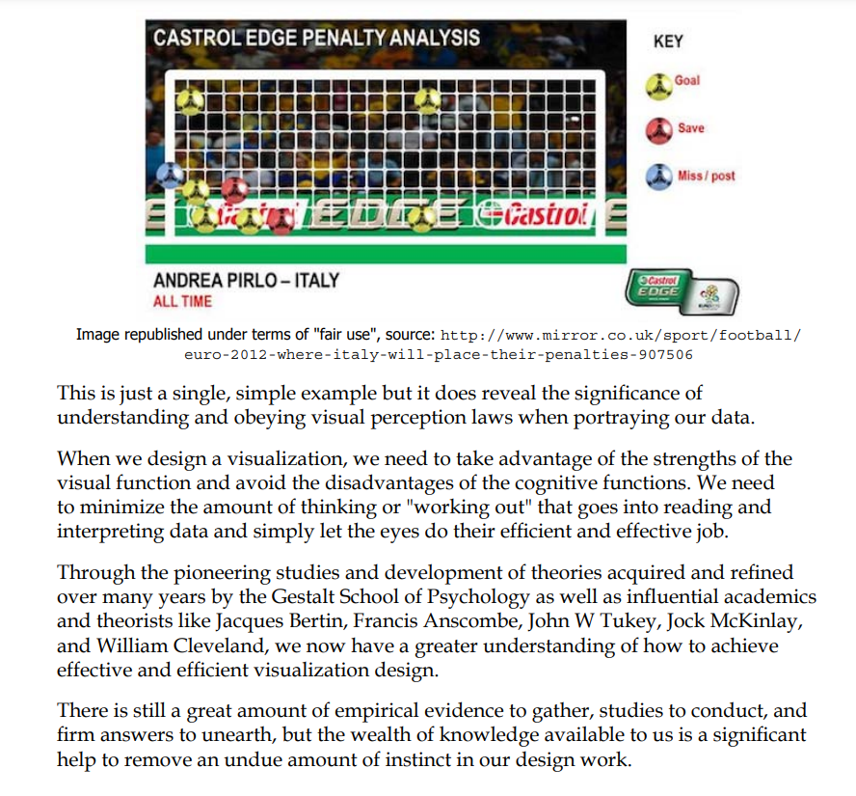
The bedrock of visualization knowledge

Slide 13
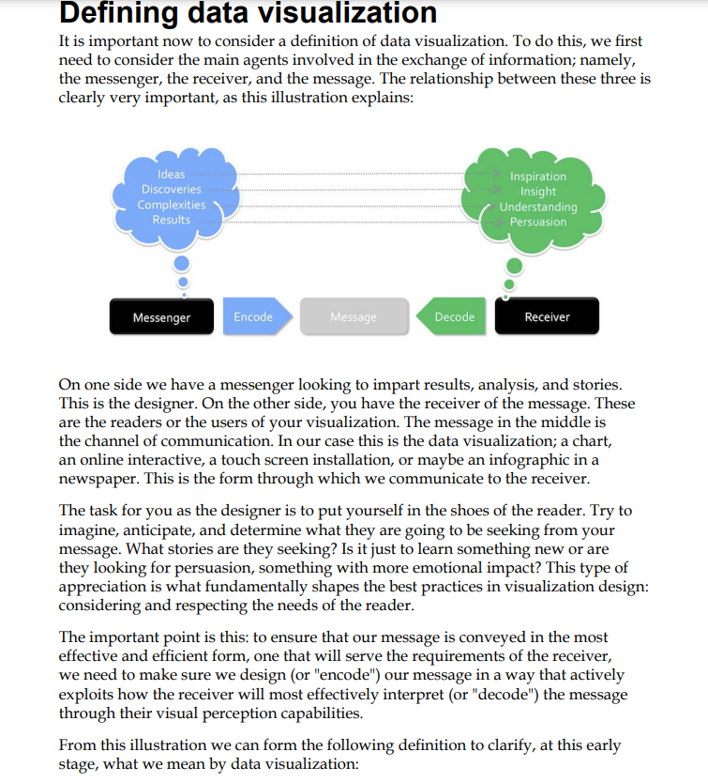
Defining data visualization

Slide 14
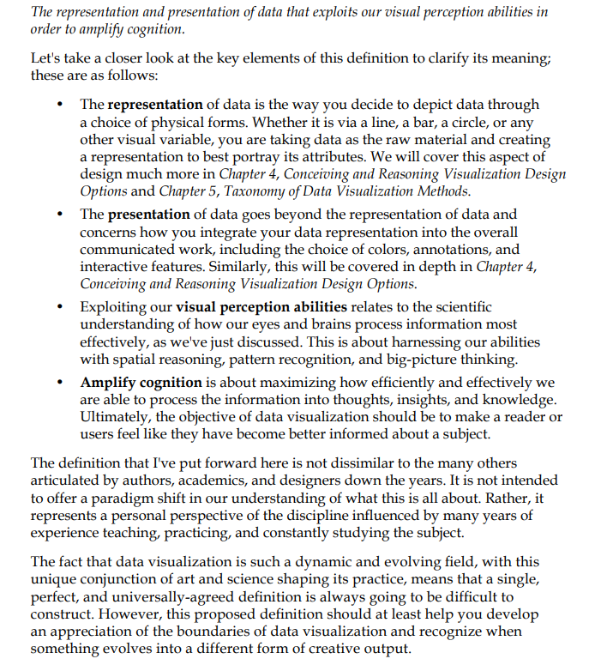
Defining data visualization

Slide 15
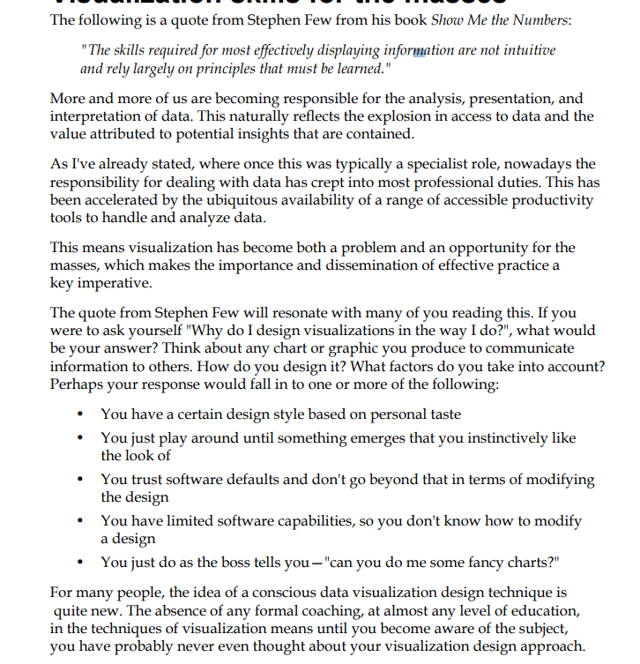
Visualization skills for the masses

Slide 16
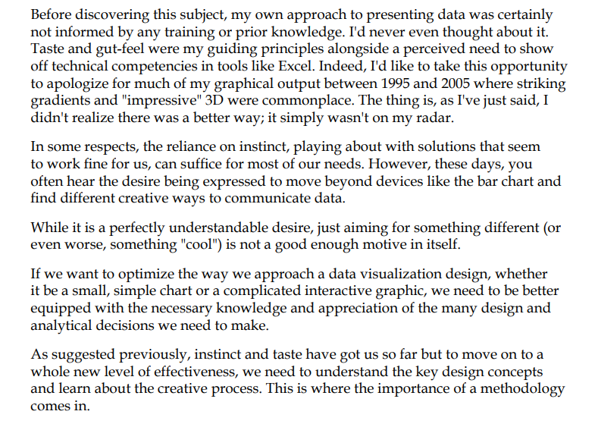
Visualization skills for the masses

Slide 17
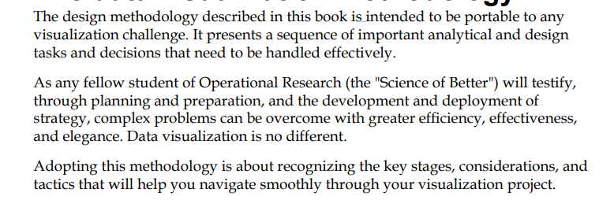
The data visualization methodology

Slide 18
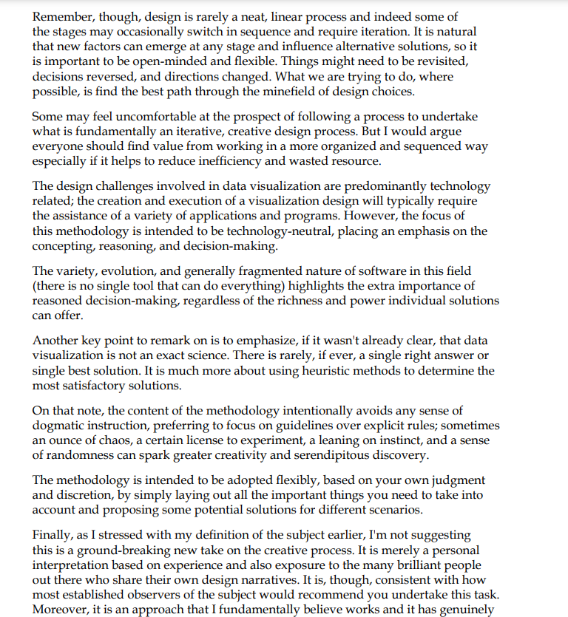
The data visualization methodology

